Slide 1
GUess
Sahiti Kattamedi, Neha Khan, Jorge Mejia, Jesse Ortiz
Professor Mohamed Aly
12/16/2022

Slide 2

Overview
Abstract
Video demonstration
Code
Test Benches
Meet the team

Slide 3
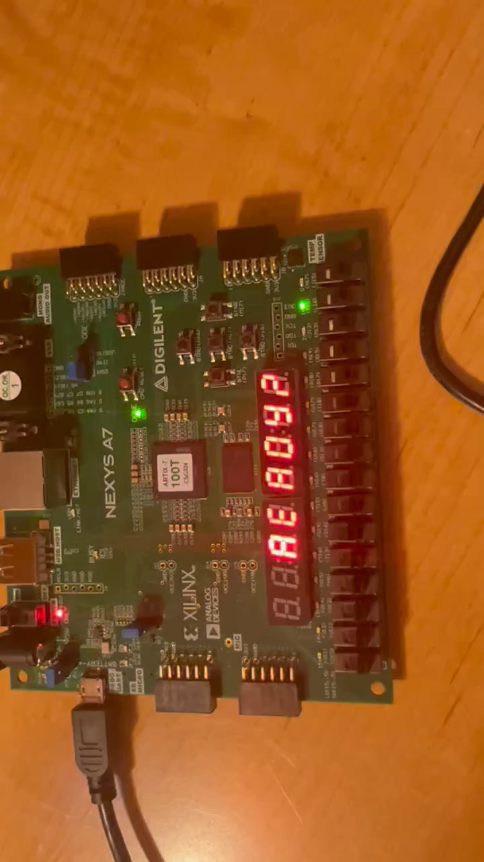
Video Demonstration

Slide 4

Abstract
Our project is a guessing game with the user against the program. When first starting the game, the program will generate a random number from 0 through 7. Initially, three LEDs will be on that represent the user’s tries. The user will then use the first three switches to pick their number and then use the button to confirm. The program will compare the number it generated to the number from the user. If wrong, one LED will turn off, the seven segment will show the number of lives, and the VGA should turn the screen red if the user lost all three rounds. If correct, then the screen will be green, and the seven segment will tell they user they won.. In-between the screen will be black.

Slide 5
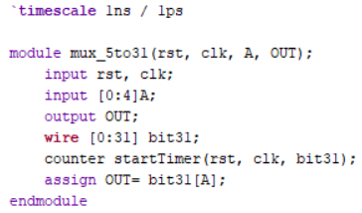
5x31 Multiplexer

Slide 6
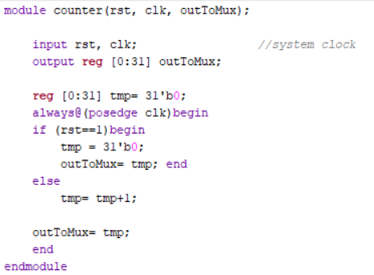
Counter

Slide 7
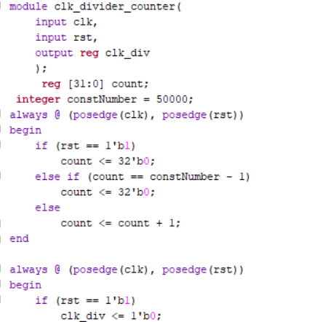
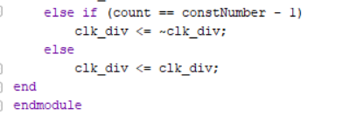
Clock Divider Counter

Slide 8
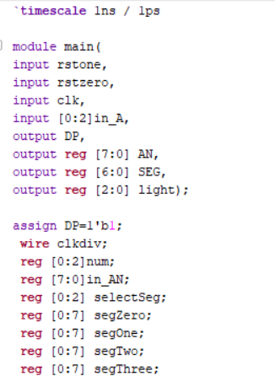
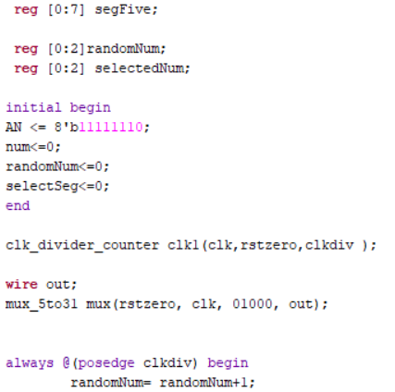
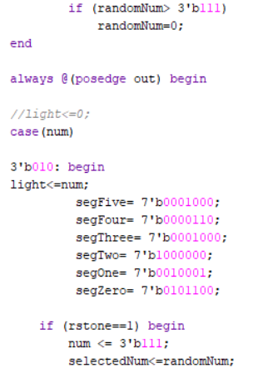
Main

Slide 9
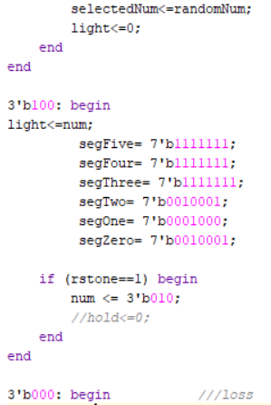
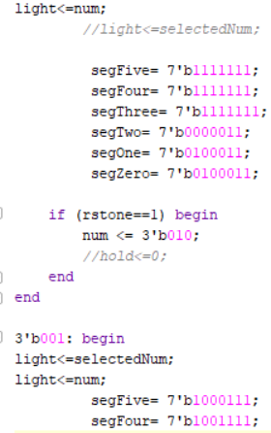
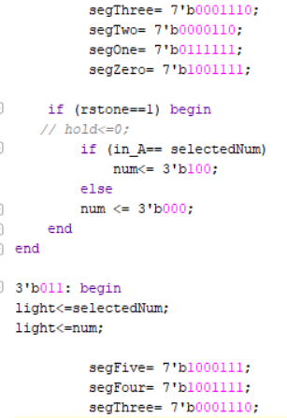
Main Cont.

Slide 10
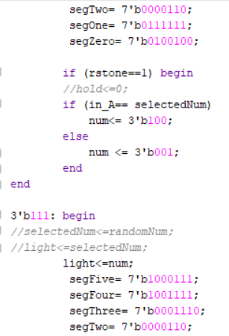
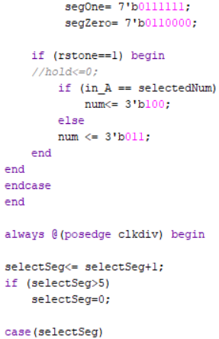
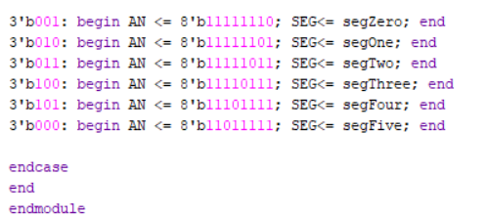
Main Cont.

Slide 11
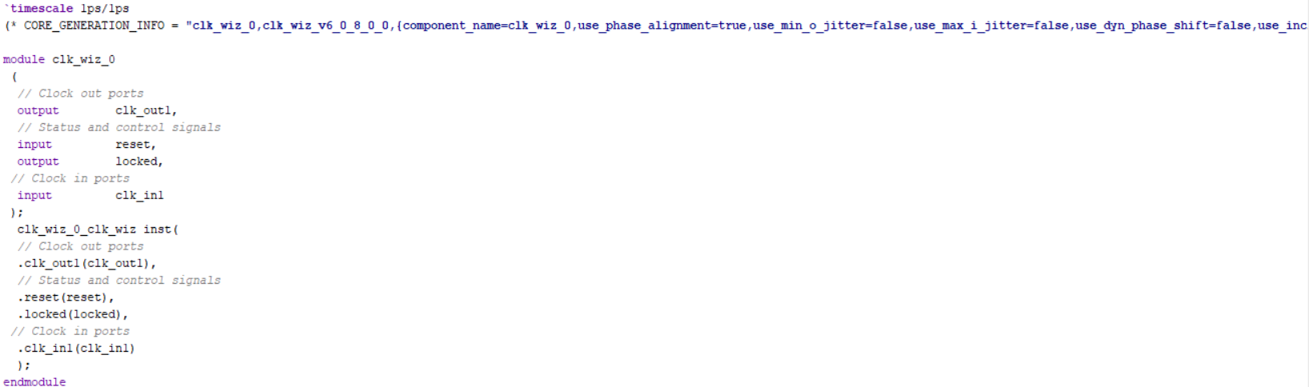
VGA Clock

Slide 12
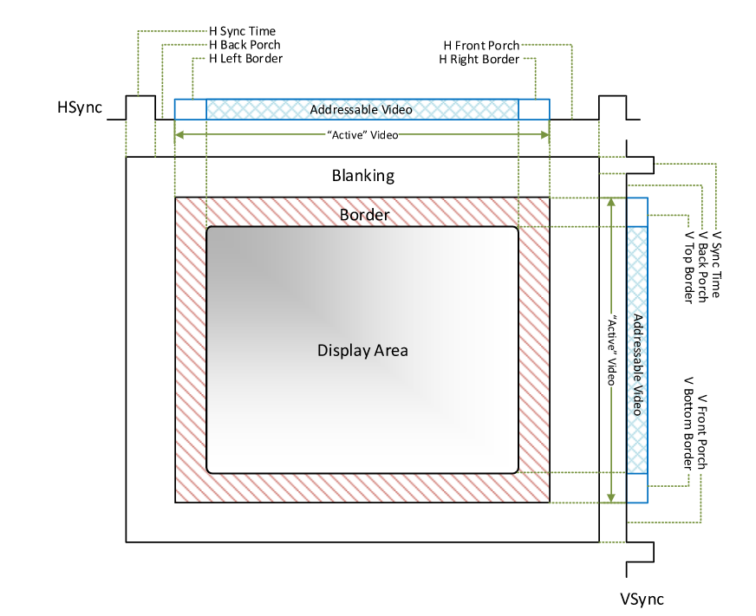
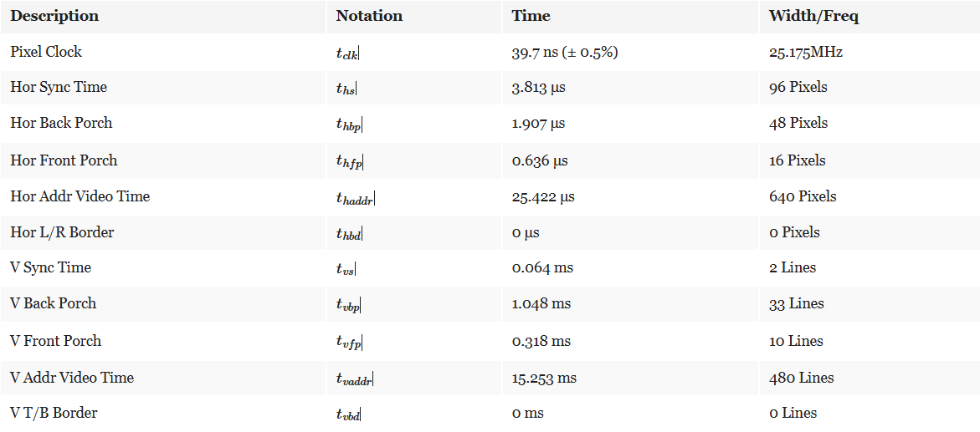
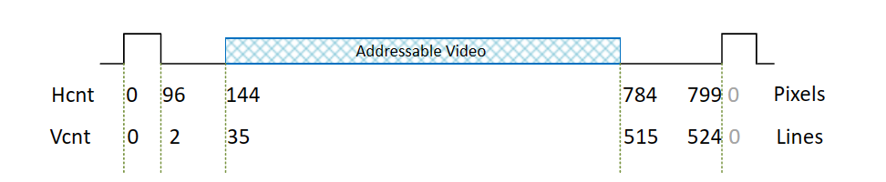
VGA

Slide 13
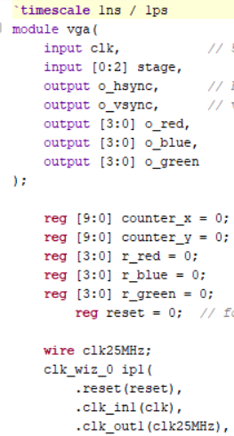
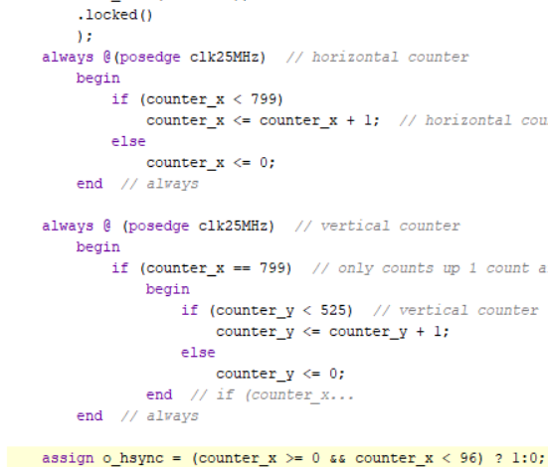
VGA

Slide 14
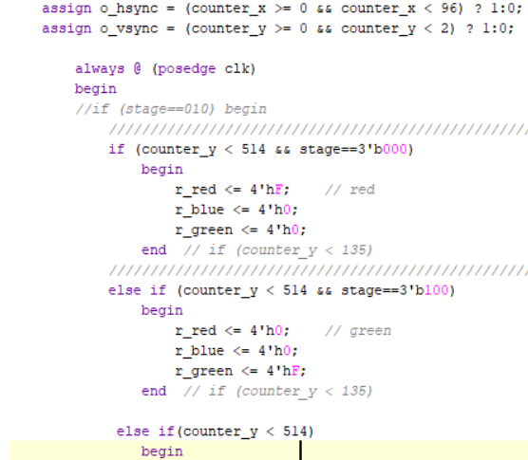
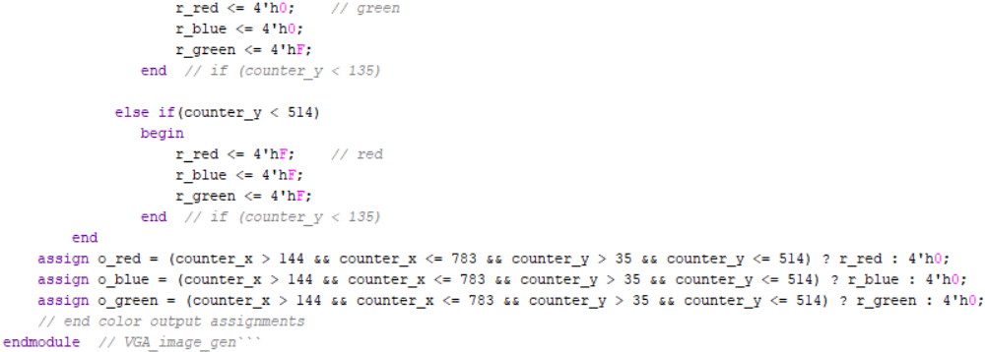
VGA

Slide 15
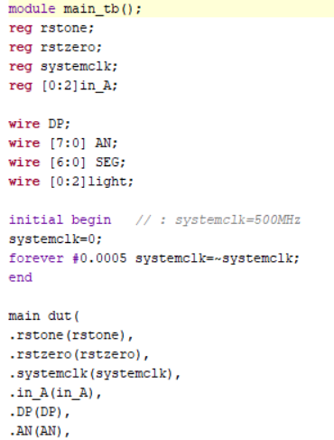
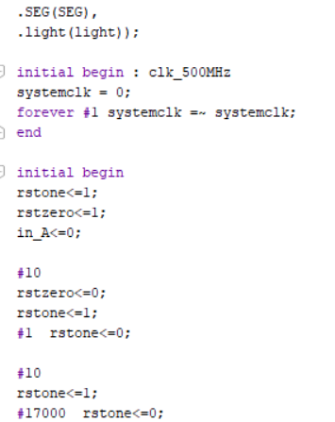
Main Test Bench

Slide 16
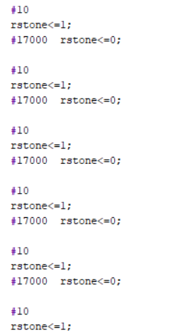
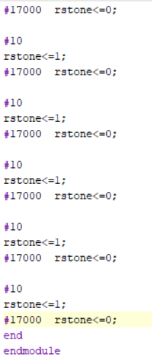
Main Test Bench

Slide 17
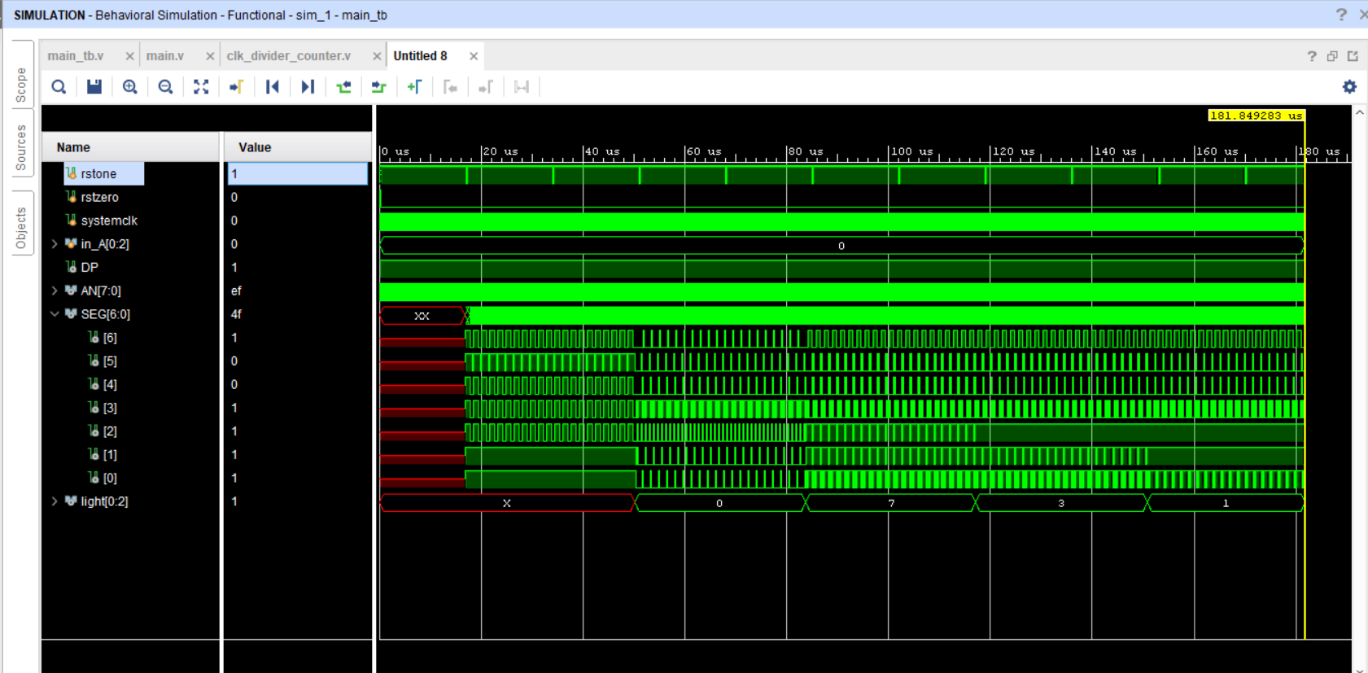
Main Test Bench Output

Slide 18
Meet our team
Clock Divider
Testbench
Counter
Main
Constraints
PowerPoint
5x31 Mux
Testbench
Main
Constraints
Github
PowerPoint
VGA
Testbench
Main
Constraints
Testbenches
PowerPoint
Counter
Testbenches
Main
Constraints
PowerPoint
Sahiti Kattamedi
Neha Khan
Jorge Mejia
Jesse ortiz

Slide 19

Thank you

